Slide 1
Name : BARUN KUMAR
Roll no. : 18125760015
Mid Term Report

Slide 2
Default of Credit Card Clients

Slide 3
Problem Statement
The problem finding the patterns in customer behaviors that help predicting if a customer have a chance of getting his credit card defaulted before the 6 months period. By applying the right algorithm and parameters we can get a prediction on the 5th month or even 4th month to know if the customer have high chance of getting his credit card defaulted
This research aimed at the case of customers default payments in Taiwan and compares the predictive accuracy of probability of default among six data mining methods.

Slide 4
Business Understanding
Banks consider the denial of credit applications to risky customers an important priority in order to avoid undesirable decisions and consequences, like granting a customer a credit limit increase to risky customers. For example, a customer who has skipped making the minimum payment for several months. In such case, the credit card should be set to default after the customer has failed to make a payment for 6 months in a row. A credit default is a credit status applied when a customer fails to make the minimum payment for 6 months.
Risk Management is important field in Banking, and when we are talking about credit cards, credit risk management will be the first line of defense for any credit decision. Performing credit risk management correctly allows banks to minimize the risk associated with credit cards.

Slide 5
Approach
The Goal is to train a model with the capability to minimize the risk by making predictions based on the dataset.
The model predicts whether a late-paying customer will only be late for a limited duration (1 or 2 months), or if this customer is predicted not to make a payment at all.
This makes it a classification problem.

Slide 6
Data Understanding
The dataset that will be used for this project is the “Default of Credit Card Clients Dataset.
Dataset portrays information about a bank’s credit card clients along with their marital status, their balance limit, education, when they paid respective bill amounts.
Size: 30000 instances, 23 predictors and a response variable.
No missing values
Error in the naming of variable Pay_0, it was changed to Pay_1
Certain numeric attributes were converted to nominal.
  Nominal attributes include: SEX, EDUCATION, MARRIAGE, PAY_1 to Pay_6 & default payment next month
In the education variable, the values ‘0,4,5,6’ are combined to one value as value ‘4’

Slide 7
This research employed a binary variable, default payment (Yes = 1, No = 0), as the response variable. This study reviewed the literature and used the following 23 variables as explanatory variables:
X1: Amount of the given credit (NT dollar): it includes both the individual consumer credit and his/her family (supplementary) credit.
X2: Gender (1 = male; 2 = female).
X3: Education (1 = graduate school; 2 = university; 3 = high school; 4 = others).
X4: Marital status (1 = married; 2 = single; 3 = others).
X5: Age (year).

Slide 8
X6 - X11: History of past payment. We tracked the past monthly payment records (from April to September, 2005) as follows:
  X6 = the repayment status in September, 2005;
  X7 = the repayment status in August, 2005; . . .;
  X11 = the repayment status in April, 2005.
  The measurement scale for the repayment status is: -1 = pay duly; 1 = payment delay for one month; 2 = payment delay for two months; . . .; 8 = payment delay for eight months; 9 = payment delay for nine months and above.
X12-X17: Amount of bill statement (NT dollar). X12 = amount of bill statement in September, 2005; X13 = amount of bill statement in August, 2005; . . .; X17 = amount of bill statement in April, 2005.
X18-X23: Amount of previous payment (NT dollar). X18 = amount paid in September, 2005; X19 = amount paid in August, 2005; . . .;X23 = amount paid in April, 2005.

Slide 9
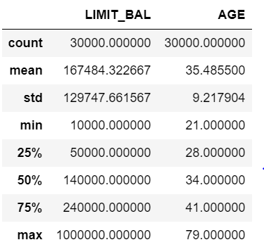
Dataset Summary

Slide 10
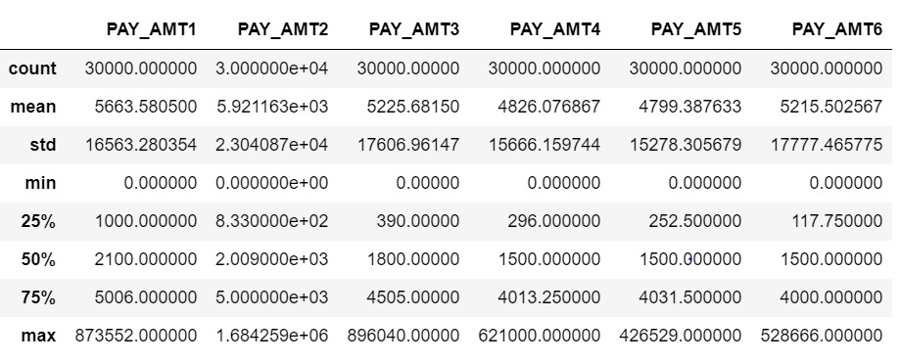

Slide 11
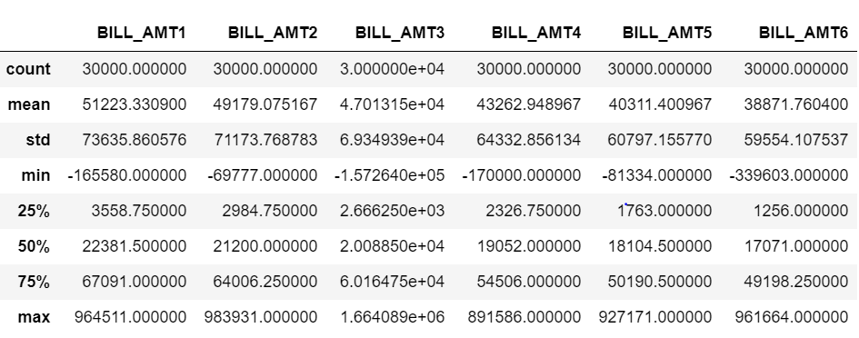

Slide 12
Exploratory Data Analysis & Data Visualization
All attributes have numeric set of values
The dataset is of the form (n>p) where n= number
of instances and p= number of attributes.

Slide 13
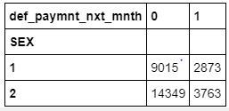
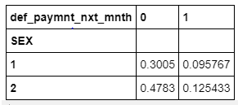
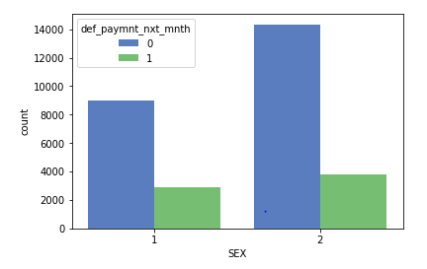
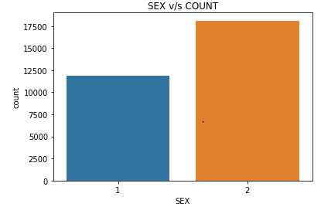
Number of female credit card holder is more than male,
Also proportion of default is more in female (1 – m ; 2 - f)

Slide 14
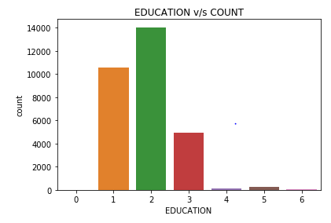
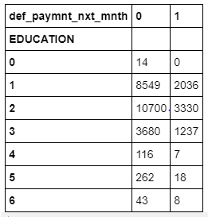
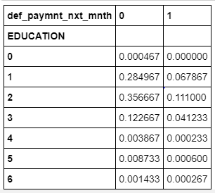
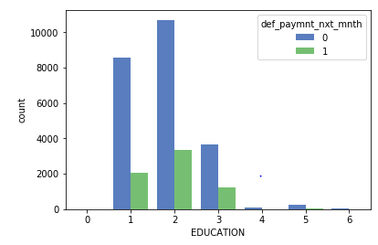
From plot, it is clear that those people who are graduates have less default payment proportion wrt university and high school students (1 = graduate school; 2 = university; 3 = high school; 4 = others)

Slide 15
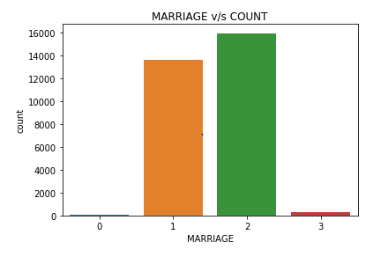
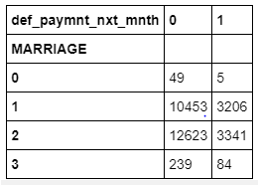
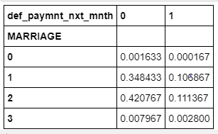
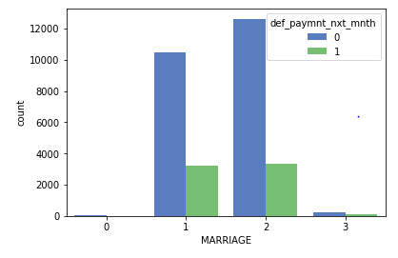
From plot, it is clear that those people who have marital status single have less default payment wrt married status people (1 = married; 2 = single; 3 = others)

Slide 16
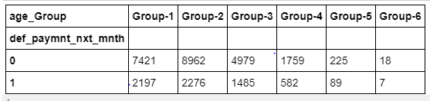
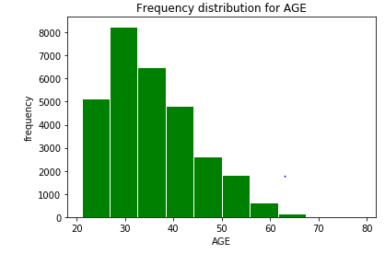
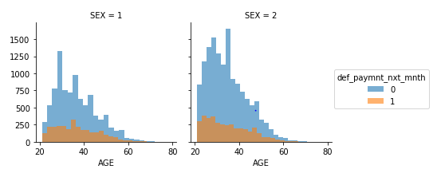
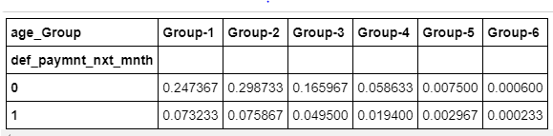
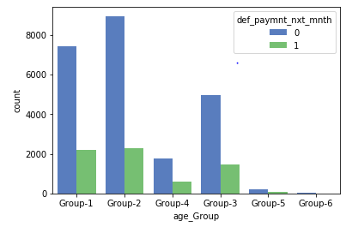
A count of the number of defaults is generated against age groups
The younger age groups have been observed to default more than the other age groups.

Slide 17
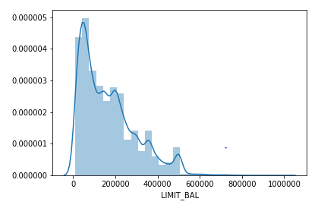
Distribution for Limit Balance

Slide 18
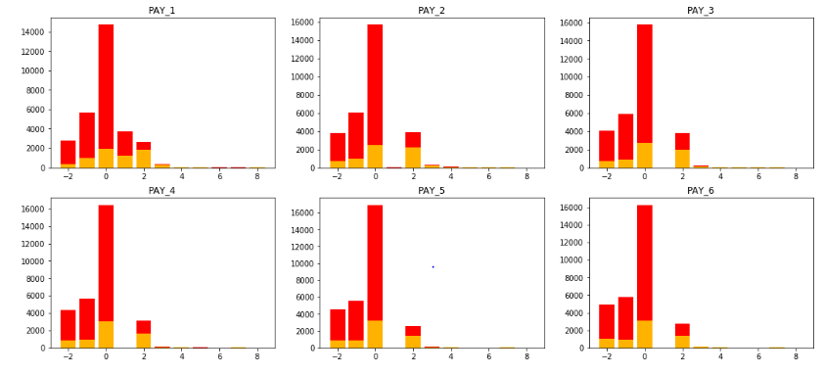
The figure shows bar plot for each month payment status which show the count of defaulters and non-defaulter.

Slide 19
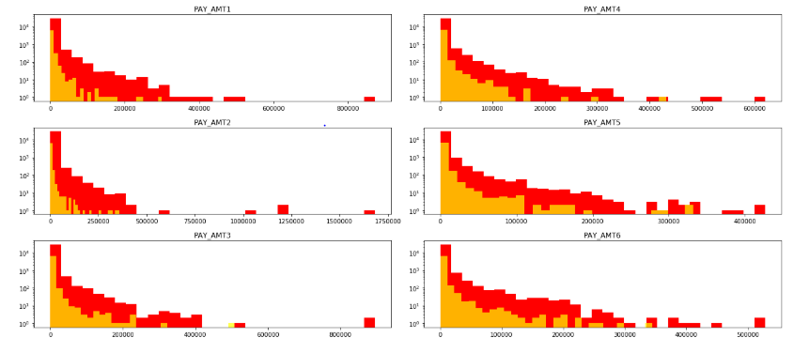
The histogram shows the distribution of payment amount for each month explicitly for defaulters and non-defaulters

Slide 20
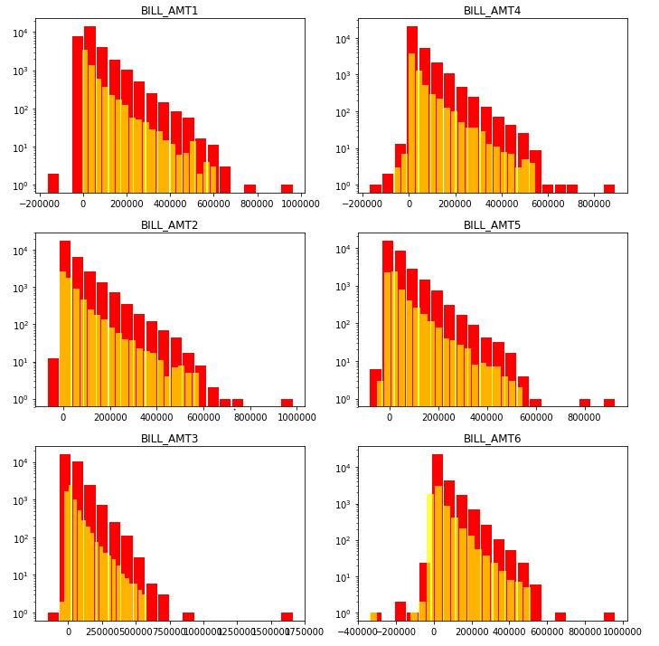
The histogram shows the distribution of Bill amount generated for each month explicitly for defaulters and non-defaulters

Slide 21
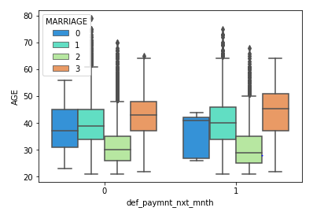
sns.boxplot(x='def_paymnt_nxt_mnth',y='AGE',data=data,palette='rainbow')

Slide 22
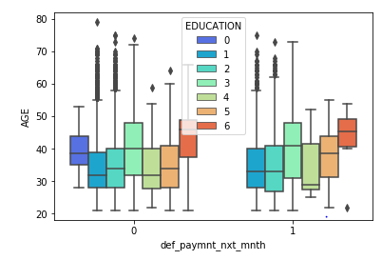
sns.boxplot(x='def_paymnt_nxt_mnth',hue='MARRIAGE', y='AGE',data=data,palette="rainbow")

Slide 23
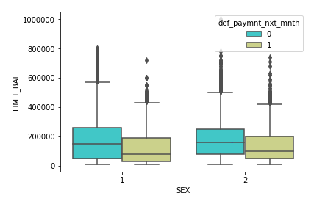
sns.boxplot(x='def_paymnt_nxt_mnth',hue='EDUCATION', y='AGE',data=data,palette="rainbow" )

Slide 24
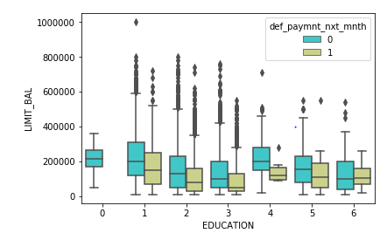
sns.boxplot(x='SEX',hue='def_paymnt_nxt_mnth', y='LIMIT_BAL',data=data,palette="rainbow")

Slide 25
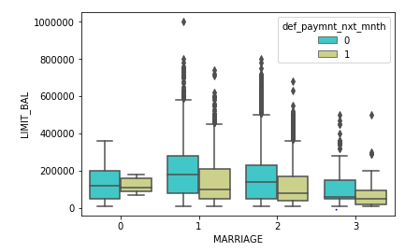
sns.boxplot(x='MARRIAGE',hue='def_paymnt_nxt_mnth', y='LIMIT_BAL',data=data,palette="rainbow")

Slide 26
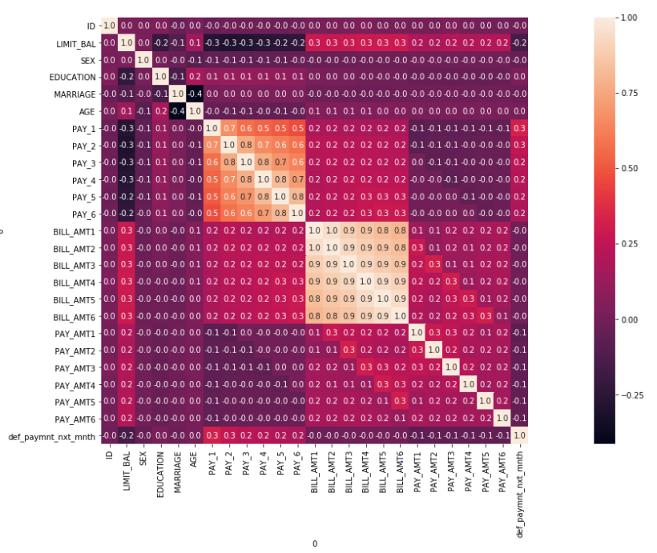
Correlation Matrix of Data Set

Slide 27
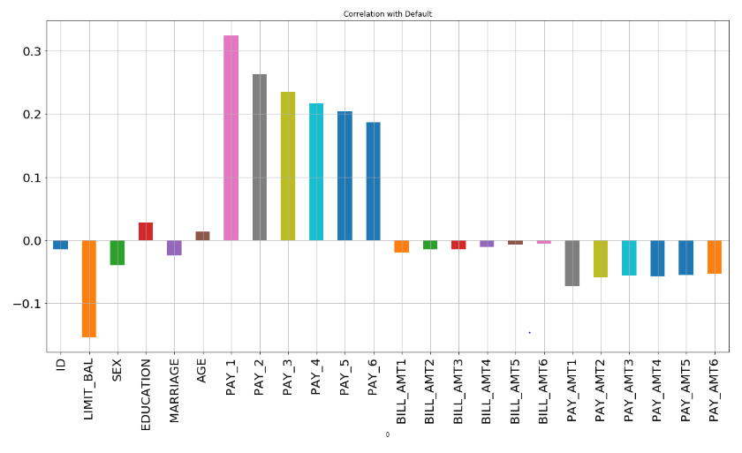
It seems from the graph that most negatively correlated feature is LIMIT_BAL but we cannot blindly remove this feature because according to me it is very important feature for prediction. ID is unimportant and it has no role in prediction so we will remove it later.

Slide 28
Data Preparation
The attribute name ‘PAY_0’ was converted to ‘PAY_1’ for naming convenience.
Numeric attributes were converted to nominal.
Values in the ‘EDUCATION’ variable will be grouped such that the values ‘0,4,5,6’ was combined to one value and assigned a value ‘4’.
For all classification tasks, target variable was converted to numeric.

Slide 29
List of References
http://jmlr.org/proceedings/papers/v28/denil13-supp.pdf
https://stackoverflow.com/
https://www.analyticsvidhya.com/blog/
https://medium.com/

